Slide 1
Problem solving with linear equations
Task A: Solving geometric problems
1) The perimeter of this rectangle is 7. Work out the value of x
6x − 1
8x + 1
2) Find the perimeter of this equilateral triangle.
5x + 20
8x − 7
3) Two identical rectangles make this compound shape with perimeter 48. Work out the value of x
x + 4
6x − 2
4) The rectangle and the square have equal perimeters. Work out this perimeter.
8 − x
6x − 5
5x + 2

Slide 2
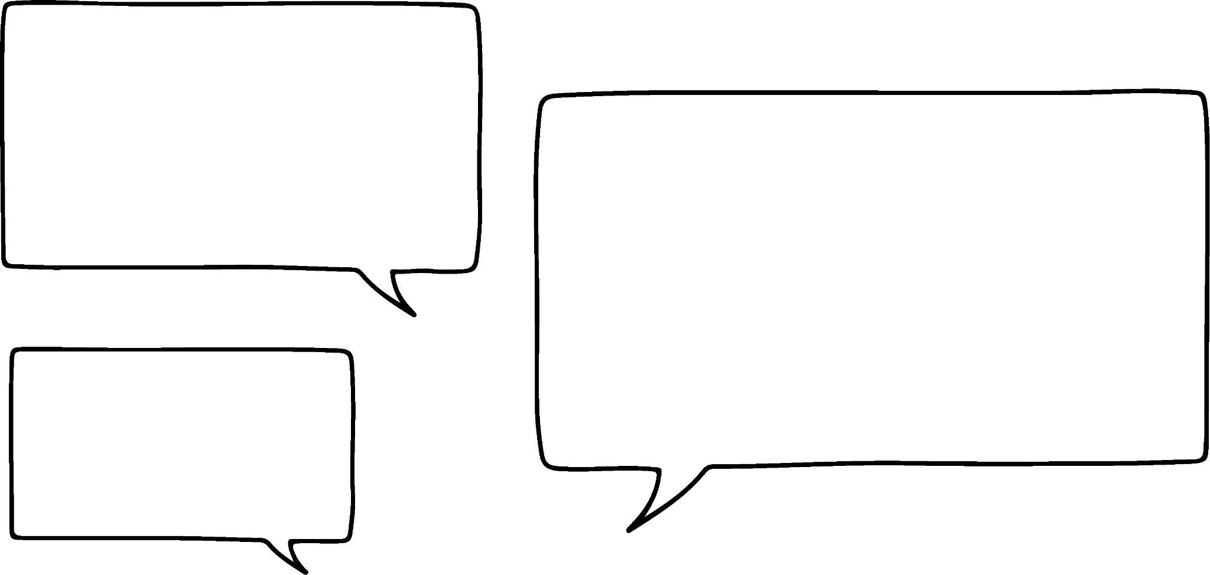




Problem solving with linear equations
Task B: Forming and solving equations from worded problems
1) a) An electrician has a call out fee and then charges £45 per hour. For an eight hour job they charge £385. Form an equation and calculate their call out fee.
b) Another electrician has a call out fee of £50 and for an eight hour job they charge £370
Form an equation to calculate their hourly rate.
2) Andeep has made two number problems.
Write an equation and find the number in each case.
a) I have a number whereby if you multiply it by 3 and add 60 it’s the same as if you multiply it by 7 and minus 8
b) I have another number whereby if you multiply it by 5 and minus 7 it’s the same as if you multiply it by 2 and minus 5
3) Jun, Aisha and Jacob are buying a present for classmates.
a) Aisha spends £2 more than Jun and Jacob spends three times as much as Jun. In total they spend £39.50 How much does Jacob spend?
b) Aisha spends £5 more than Jun and Jacob spends four times as much as Aisha. Jacob spends £33 more than Aisha. How much does Jun spend?
Mathematics in Education and Industry.
v2.3

